Slide 1

Fiscal Year 2012/13
Budget Highlights
$ 81.5 million

Slide 2
FY 2012/13 Balanced Budget
“Stays the course” and “follows the financial plan”
we established several years ago and continues our history of:
    Maintaining healthy cash reserves
    Significant General Fund levy growth available
    Conservative spending
    Stable revenue streams
    Strong fiscal planning and adherence to fiscal policies

Slide 3
As part of that plan we continue to seek the proper “balance” in three key areas:
Recognizing the need for human resources and operating budgets to grow as the City grows. Must preserve the high quality of services our Citizens have grown to expect. | VS. | Too conservative spending - cannot sustain FROZEN operating budgets long term. May lose sight of being responsive to needs of the City.
Funding an aggressive CIP program needed to support our growing community with quality amenities, and as a result, accepting that we may have a higher Debt Levy Rate and Debt Margin Ratio than comparable Cities | VS. | Picking an arbitrary Debt Levy Rate or Debt Margin Ratio to live within……that may not allow the growth needed to maintain/upgrade our existing infrastructure or satisfy our future needs as a growing community
Making difficult decisions of increasing revenues through taxes and user fees “incrementally” to “pay as you go” as our costs increase | VS. | Deferring or holding off on raising fees and taxes and later having to “spike” the rates to balance the budget

Slide 4
We recommend a balance within those three key areas by:
1) Continuing our conservative spending:
  We recognize the need in several areas to add personnel and increase corresponding operating costs as the City continues to grow
  But find it prudent to wait for the outcome of Governor’s Commercial Property Tax Rollback proposal and potential capping of future growth from property tax revenue.
    Impact:
  Most operating budgets continue to be frozen, but adequately fund all current City services and public safety operations
  Recommend deferring the Fire Chief’s staffing plan to future years

Slide 5
Recommended balance of three key areas continued:
2) Funding Aggressive CIP Program previously discussed:
  Supports our growing community’s infrastructure needs
    (New and existing Roads, Stormwater improvements, Sewer expansion)
  Maintains and enhances our City’s Cultural and Recreation amenities (FMAS exhibits, Parks, Recreation Trails, Golf improvements etc.)
    Impact:
  Maintains Debt Levy Rate at $5.00 per $1,000 assessed taxable valuation
  Maintains legal Debt Margin Ratio at approximately 75%

Slide 6
Recommended balance of three key areas continued:
3) Lastly, continuing our practice of “raising revenues incrementally” to “ pay as we go” as our annual costs increase:
    User Fees:
  Recommend “planned” incremental increases in several Enterprise Funds’ user fees:
    3% Garbage, $.20 Sewer, $.35 Stormwater . The increased user fees will continue to allow those operations to be self-sufficient and are primarily project driven.
    Property Taxes:
  We do recommend LOWERING current levy rate $.10, from $12.60 to $12.50.
  However, despite the levy rate reduction, taxes on residential property will increase:
    4.58% increase in the state mandated rollback on residential property (48.53% to 50.75%); and
    1.8% average increase in assessed valuations city wide.
      Net of the reduction in the levy rate, we will still benefit from $1.2 million of additional taxes needed to support current City operations.
  Bettendorf continues to realize Excellent Growth in our tax base which allows greater flexibility for budget priorities. Gross values increased $109.5M or 4%. ($84.9M new construction, $24.6M re-valuations by Co Assessor)

Slide 9
Budget Highlights - FY 2012/13 Balanced Budget:
1) $.10 REDUCTION in the City’s Levy Rate: $12.50
Bettendorf is one of a few Iowa cities with it’s general fund levy rate significantly below $8.10. Allows 32.4% levy growth equating to $4.53 million of potential property taxes
 | FY 11/12 | FY 12/13
General Fund | $5.49661 | $5.47886
Health Insurance | 1.11887 | 1.00056
Liability Insurance | .31872 | .33719
Police & Fire Pension | .66580 | .68339
Debt Service | 5.00 | 5.00
New Levy Rate | $12.60 | $12.50

Slide 10
Annual Property Tax Impact:
Levy Reduced $0.10 to $12.50
Residential | Increase/Decrease
$100,000 Assessed Value | +$23.41 ($1.95 per month)
$162,235 Assessed Value (Median) | +$37.67 ($3.14 per month)
$250,000 Assessed Value | +$57.79 ($4.82 per month)
Commercial | Increase/Decrease
$253,510 Assessed Value (Median) | -$25.35 (-$2.11 per month)
$500,000 Assessed Value | -$50.00 (-$4.67 per month)
Despite the levy rate reduction, taxes on residential property will increase due to:
  4.58% increase in the state mandated rollback on residential property (48.53% to 50.75%)
  1.8% average increase in assessed valuations city wide

Slide 11
Taxes Current Year
How We Compare to Other Cities?
In order by Levy Rate of all Iowa cities with populations over 20,000, plus Clive

Slide 12
FY 2012/13 Budget Highlights
  Provides funding for all existing City services:
    Maintains stable operating budgets. Largest increases resulting from utilities and fuel related costs. Continues close monitoring of over-time
      Defers Fire Chief’s staffing plan and eliminates 1 FT Grant Administrator position through a retirement
      Funds Road Salt budget and liquid application program at $800,000
      Continued commitment towards Code Enforcement Program and rental inspections: $115,000
      Funds salary study for non-union employees: $20,000
    Funds wage increases for all union and non-union employees

Slide 13
Union Settlements
Funds third year of four year contracts with all of our bargaining units
Bargaining Unit | FY 10/11 | FY 11/12 | FY 12/13 | FY 13/14
Fire | 0% COLA 2% Deferred | 1.50% COLA 7/1/11 1.50% Deferred 1/1/12 | 2.75% COLA | 2.90% COLA (plus 1% if pension is <35.32%)
Police | 2% COLA | 2.35% COLA .50% Deferred | 3% COLA .25% Deferred | 2.75 COLA .75% Deferred
AFSCME - General | 2% COLA | 3% COLA | 3.25% COLA | 3.50% COLA
AFSCME - Library | 2% COLA | 3% COLA | 3.25% COLA | 3.50% COLA
Non-Union Employees | 2% COLA | 3% COLA | 3.25% COLA | 3.50 COLA

Slide 14
FY 2012/13 Budget Highlights:
3) Projects Major Revenues to remain Stable

Slide 15
Building Permit History

Slide 16
FY 2012/13 Budget Proposes:
4) All Major Fund Balances to remain stable

Slide 17
FY 2012/13 Budget Highlights:
5) Health Insurance –
Continued aggressive management of our Health Insurance Fund.
    Recommend renewal with Wellmark with 6% increase in “total projected maximum costs” vs. 11% national
    History of health claims: 8 year average increase 4.17% (National average 11%)
    Increase Specific Stop Loss from $50K to $70K
    Ample cash reserves in excess of $1 million are available to fund claims up to maximum aggregate attachment point (125% of expected claims)
    Health Committee continues to meet regularly to monitor our existing health care plan

Slide 18
FY 2012/13 Budget Highlights:
6) Liability Insurance –
Total Liability Insurance up $89,736 or 14.15%.
  Workers Compensation Fees up: $39,851 or 10%
      Increased Mod rate from 1.13 to 1.20 due to Actual Losses exceeding Expected losses in each of last 3 three years AND our last “good” year of actual losses dropped off – 2008
      Striving to manage our Work Comp insurance costs although…..
        Continue to have increased wages
        7% to 21% State of Iowa published rate increases on various job classifications
  Third year of equity refund on Property Insurance from ICAP dropped off: $35,430

Slide 19
FY 2012/13 Budget Highlights:
7) Gaming Revenue - $1.670 million
$1.464 million allocated to supplement operating budgets for:
Enterprise Funds - $888,688 down from $1,047,663 current year
Road Use Fund (salt) - $250,000
Economic Development - $205,702
Other Funds - $120,000
If not for Gaming Revenue, user fees would be significantly higher or property taxes would be needed to supplement budgets.

Slide 20
8) Community Improvement Program
2012 Construction Season: $15.2 million
  $2.15 million: 2nd Phase of Tanglefoot, 18th Street to Greenbrier: 3 lanes with 10’ separated recreation trail on north side, preliminary work on phase III
  $1.075 million: 1st Phase of Hopewell Ave paving, Middle Rd to east line of Century Heights to 18th addition.
  $1.85 million: Utica Ridge Road: Spruce Hills Dr to Tanglefoot Lane – 5 lane
  $1.68 million: Various separated trails: Along Middle Rd from Devils Glen to Duck Creek ($742,000 Federal Funding) and along Devils Glen Rd east side from Middle Rd to Devils Glen park and start of phase II north of Middle Rd to Crow Creek Park
  $1.5 million: Sealcoat Replacements including 25th Street – Oak to Glen; Cody – 25th to 26th Street; Elm Street from 35th Street 700 feet east to bike trail to overlook
  $1.445 million: 29th Street: Maplecrest Drive to Tanglefoot Lane
  $965,000: Various Street Overlays
  $685,000: Various Undesignated Street Reconstruction
  $565,000: Various Sidewalks

Slide 21
Community Improvement Program 2012 Construction Season: $15.2 million
  $500,000: Street patching throughout the City
  $500,000: Recreation Trails along Crow Creek from Devils Glen to Field Sike; Highway 67 at Crow Creek to east City limits at Harbor Dr
  $455,000: Annual Funding for Parks Projects ($160,000 Grants)
  $375,000: Various Traffic Projects
  $300,000: Various Alley improvements
  $250,000: I-80 Water main extension
  $200,000: Forrest Grove sealcoat replacement, Phase I west City Limits to Eagle Ridge – 4 lane
$200,000: Sealcoat Rural Roads
$150,000: Façade Program and relocation program at I-74
$338,000: Various city-wide projects including salt dome roof replacement

Slide 22
Community Improvement Program continued
Enterprise Fund Projects: $2.39 million
  $1.085 million Palmer Hills Golf Course Improvements: Double Row Irrigation System, tee box, sand trap and cart path improvements, and practice range renovation
  $1.3 million FMAS: Exhibit Renovation ($756,000 grants and fund raising)
  $5,000 Splash Landing: Lift (ADA compliance)

Slide 23
Capital Equipment
Funds $1,568,856 of new/replacement Vehicles including:
$517,356: Replace Fire Engine/Pumper
$330,000: Sewer VACON & 4x4 1 ton pick-up w/crane & utility box
$225,000: 5 police Squad Cars/SUVs and 1 special Ops SUV
$164,500: 2 4x4 ¾ ton pick-up and single axle dump truck -PW
$150,000: Recycling, Rear load packer
$142,000: Line Painter, Tractor, 4x4 mower, 4x4 ¾ tone Pick-up w/plow, 4x2 ½ ton pick-up - Parks
$40,000: Stormwater, 4x4 1 ton Pick-up w/Crane and utility box
Funds $140,340 of new/replacement Electronic Equipment

Slide 24
FY 2012/13 Budget Highlights:
9) User Fees -
Continue to adjust user fees, when appropriate, to offset increases in the cost of programs.
  Garbage Fee - 3% 4/1/12
  Storm water fee - $.35 increase per ERU – 4/1/12
  Sewer Fee - $.20 per 100 cubic feet of flow – 4/1/12
  LFC – no increase
  Palmer Hills –$249 partial season pass through 7/1/12. No fee increases
  Splash Landing – small increase in pool rental fees & swim lessons
  Family Museum – small increase to comprehensive pre-school
  Transit fares – no increase
  Park & Recreation fees – introduction of $10 bus/snack fee for Playground Program, $5 increase for coach pitch baseball & softball, $11 increase for the Day Camp program

Slide 25
Proposed Solid Waste Fee Increase 3%
Continue 3% increases each April 1 to balance revenues and expenditures – BREAKEVEN
  Increased cost of vehicle replacements and shorter life
  Increased cost of labor
  Increased tonnage at landfill – largely bulky waste and e-waste

Slide 26
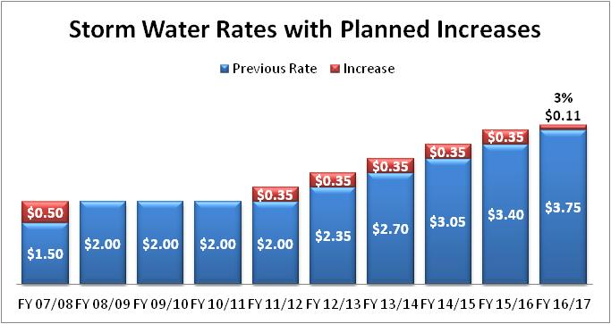
Fee increases are primarily project driven. See CIP for details.

Slide 27
$7.77 million Storm Water Projects thru FY 16/17:
$1.76 million: Stafford Creek Bank Stabilization 18th to Crow Creek Rd, Tanglefoot – Maplecrest
$1.8 million: Council priorities to be determined
$1.52 million: Small Storm Sewers, Sewer Linings & Intake Repair
$786,000 : Hopewell Creek Detention at school
$706,000: Duck Creek Stabilization, various phases
$490,000: Greenway Creek Stabilization, Terrace Park Dr to Tanglefoot Lane (Two Phases)
$160,000: 25th Street Culvert Extension
$548,928: Small stormwater projects

Slide 28
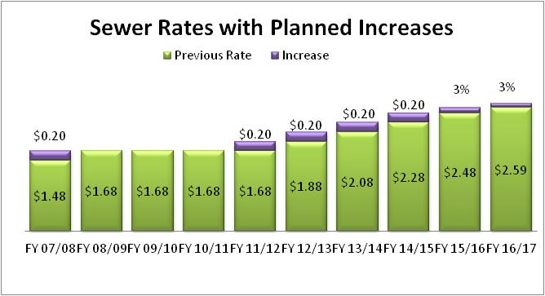
Fee increases are primarily project driven. See CIP for details.

Slide 29
$8.295 million Sewer Utility Projects thru FY 16/17:
  $5.2 million: I-80 sewer interceptor sewer from Forrest Grove to Indiana, lift station and pumps
  $1.34 million: Infiltration/Inflow analysis and city-wide improvements
  $720,000: Chimney Seals, Manhole rehabilitation, sewer televising, pipe lining
  $425,000: Hopewell Interceptor
  $310,000: various sewer improvements
  $300,000: Brookview Heights sewer extension
  $350,000: Annual debt service payment on Bettendorf’s share of equalization basin in Davenport effective FY 16/17

Slide 30
Annual Impact of Taxes & Fee Changes in
FY 12/13 Budget:
 | Residential Median Value: $162,235 | Small Business Median Value: $253,510
City’s Portion of Property Tax $12.50 levy rate ($0.10 decrease) (on Median Value Property) | +$37.67 | -$25.35
Sewer Fees $1.88 per unit ($0.20 increase) (Based on average usage) | +$17.64 (22 units/quarter) | +$45.60 (57 units/quarter)
Storm Water Fees $2.35 per ERU ($0.35 increase) (Based on average ERU) | +$5.28 (1.25 ERU) | +$51.87 (12.35 ERU)
Solid Waste Fees $12.75 per month (3% increase) (Based on 65 gal. Cart) | +$4.44 | NA
Total Increase | +$65.03 (+$5.42 per Month) | +$72.12 (+$6.01 per month)
Total Annual Cost of Services | $1,345 | $3,969

Slide 31
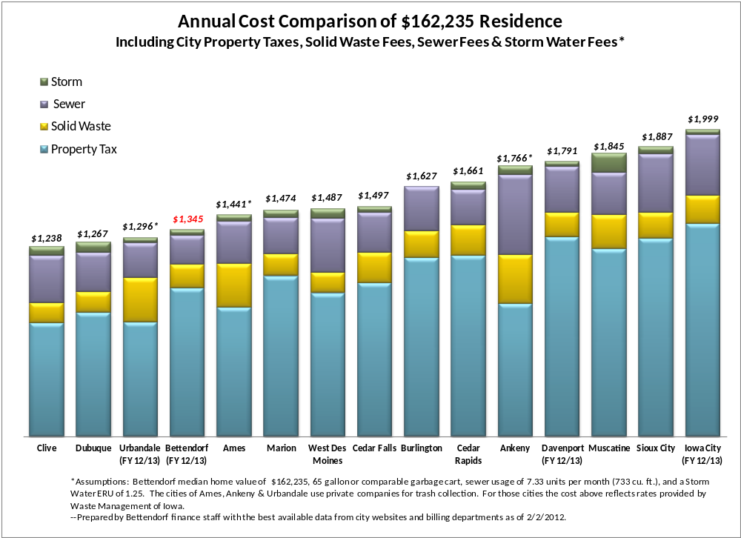

Slide 32
We are pleased to report…
a proposed $0.10 reduction in the property tax rate. Despite the reduction, homeowners will see a slight increase in the City portion of their tax bills in FY 2012/13. The $0.10 reduction eases the bump caused by the increase of the state mandated rollback and the increase in residential valuations.
The $0.10 reduction will also give across the board tax relief for commercial property owners.

Slide 33
Budget Issues for Saturday
Discussion
1) Review Major Revenue Sources
2) Review Fund Equity Balances across all funds
3) I/80 Middle Road Infrastructure and Development - discussion
4) Review Debt Practices: Debt Levy Rate and Debt Margin Ratio
5) Final review of proposed 5-year CIP Program & authorization to proceed with issuance of:
    $11 million G.O. bonds for CIP
    $700,000 General Corporate bonds for various park improvements
6) Downtown City Incentive for Private Investment
7) Fire Staffing Plan: Discussion
8) Review funding support for all Enterprise Funds and proposed increase in user fees
9) Governor’s proposal on Commercial Property Tax Rollback and limiting property tax growth

Slide 34
Budget Issues for Discussion
10) Sewer utility – Impact of waste water treatment plant improvements and timing of proposed equalization basin, INI Program
11) Review mandated increases in Police/Fire Pension and IPERS contributions
12) Review & establish Road Use Salt Budget. Update on liquid application program in current year.
13) Review proposed Renewal for Health Insurance
14) Review Liability Insurance
15) Review vehicle, electronic equipment and other miscellaneous capital equipment purchases
16) Establish the Levy Rate: Review impact of Administrative recommendation to reduce the current levy rate $ .10, from $12.60 down to $12.50 per $1,000 taxable value

Slide 35
Quote from Moody’s Investors Service April 2011 –
“The assignment of the City’s Aa1 rating reflects the city’s sound financial operations supported by solid reserves and significant revenue flexibility.
City finances are expected to remain healthy due to the existence of solid cash reserves, management’s adherence to a formal General Fund balance policy, and significant operating margin within the tax rate limit. Financial operations have consistently remained sound as the city’s General Fund has posted annual surpluses over the past ten years.”

Slide 36
    Questions
    and
    Answers

Slide 38
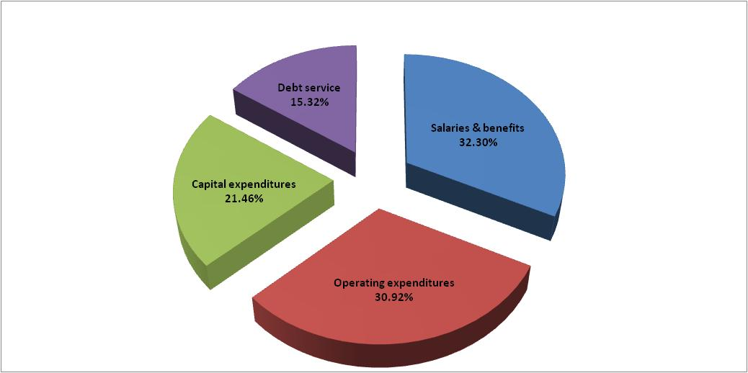

Slide 45
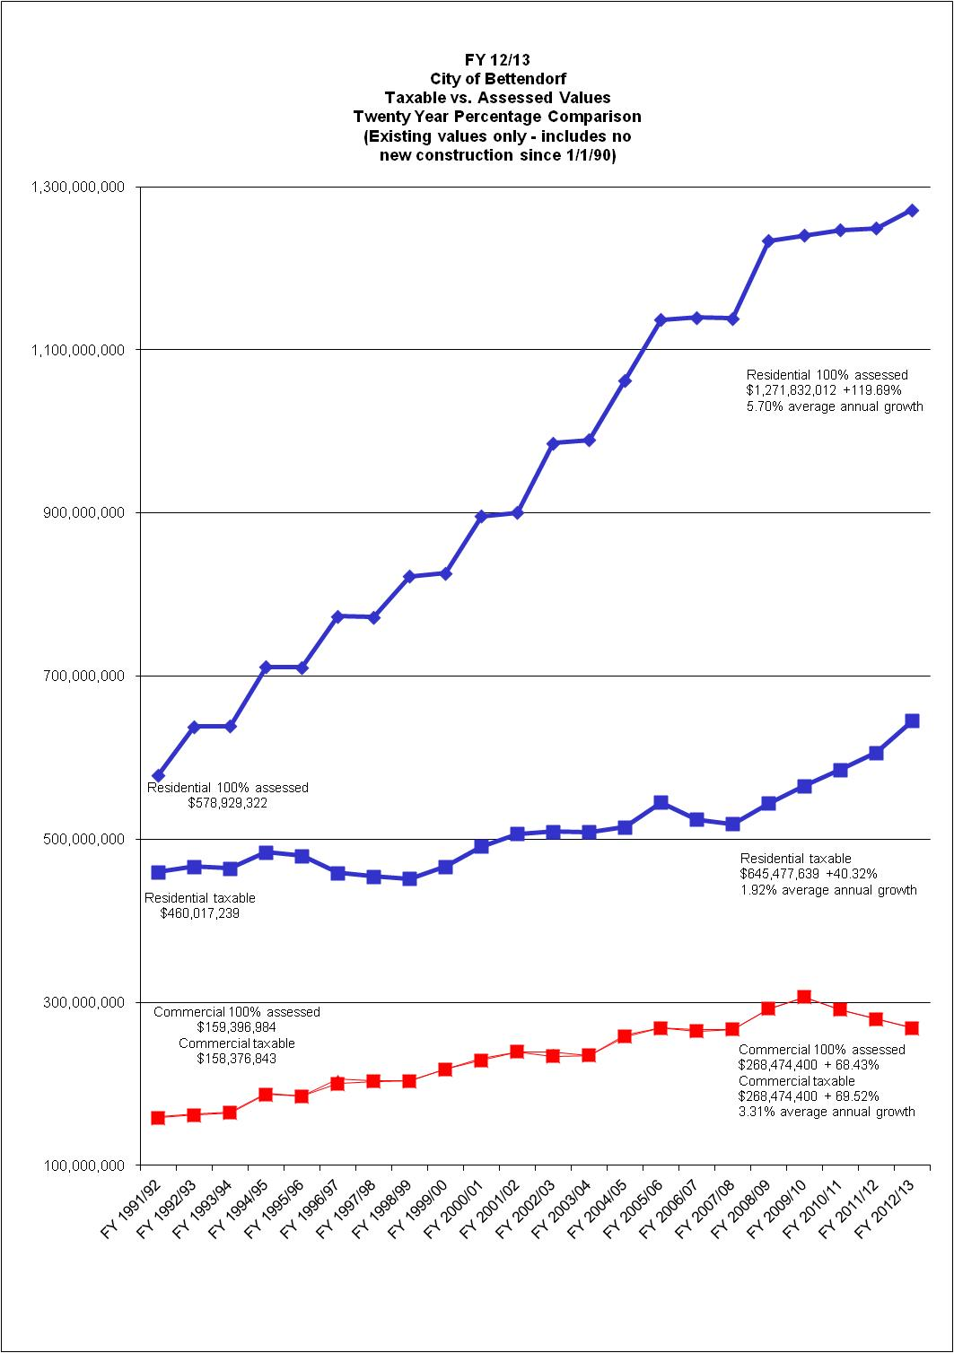
Taxable vs. Assessed Values
20 Year Percentage Comparison (Existing values only)

Slide 51
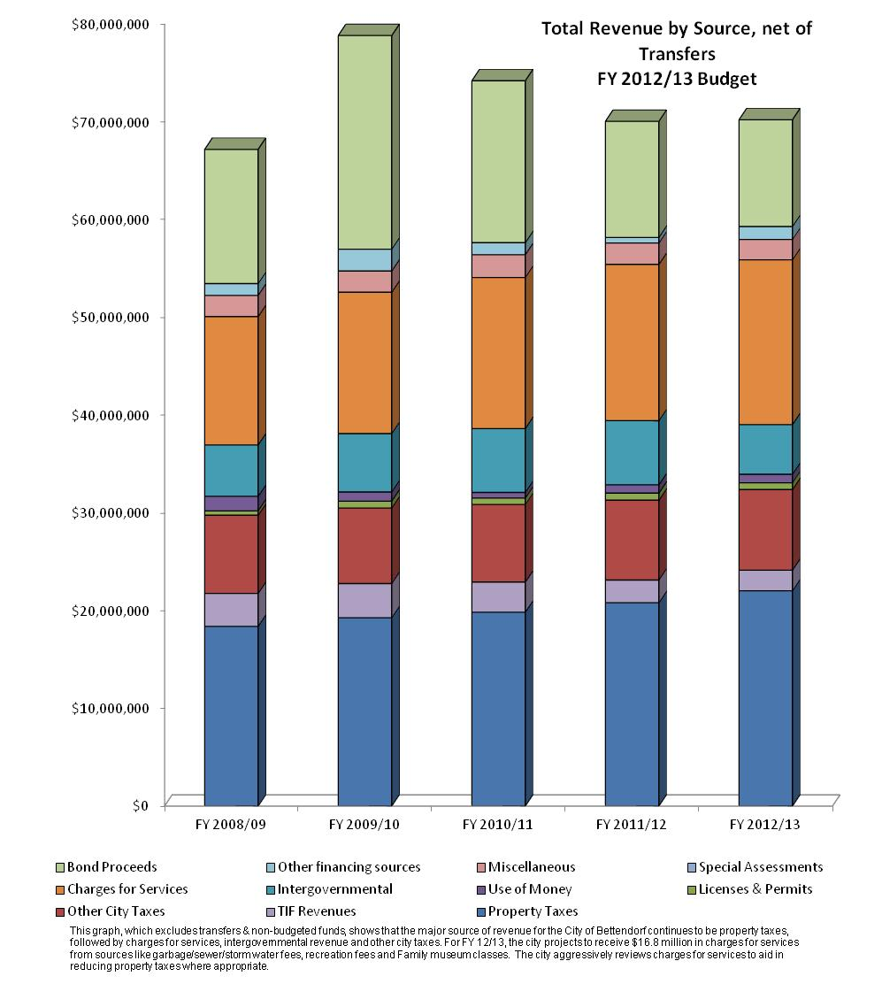

Slide 53
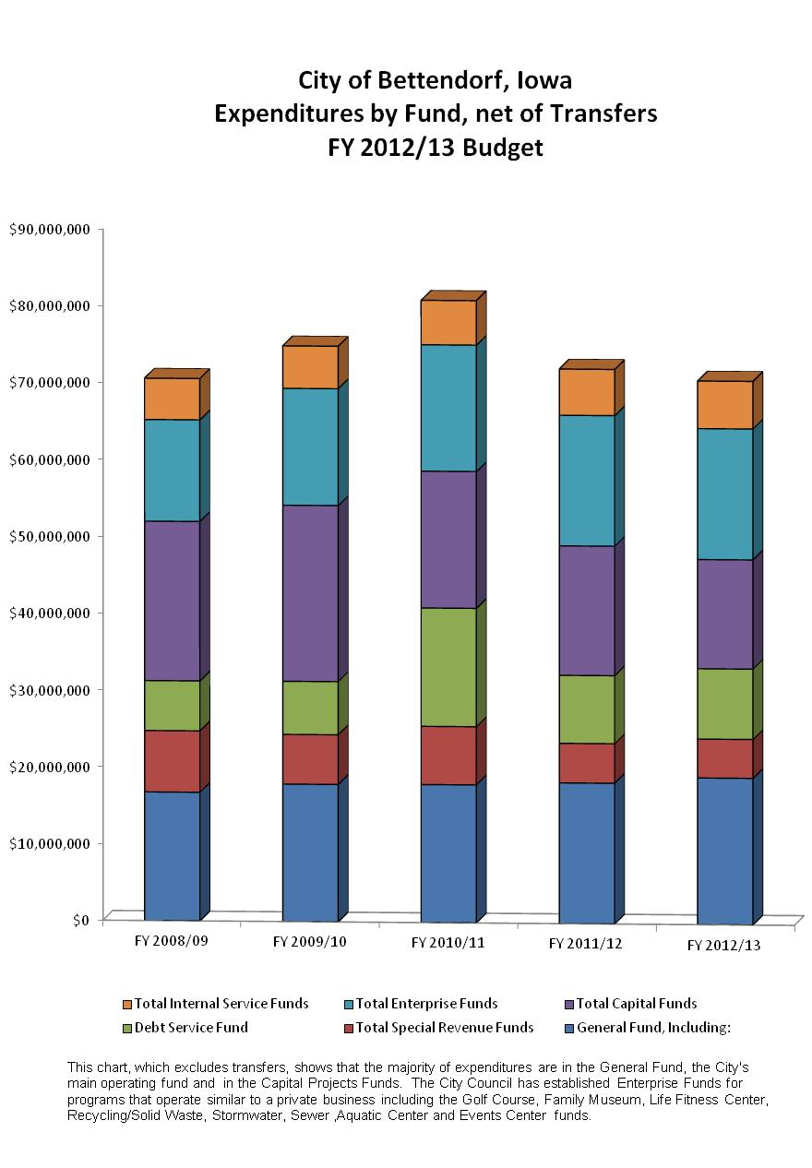

Slide 55
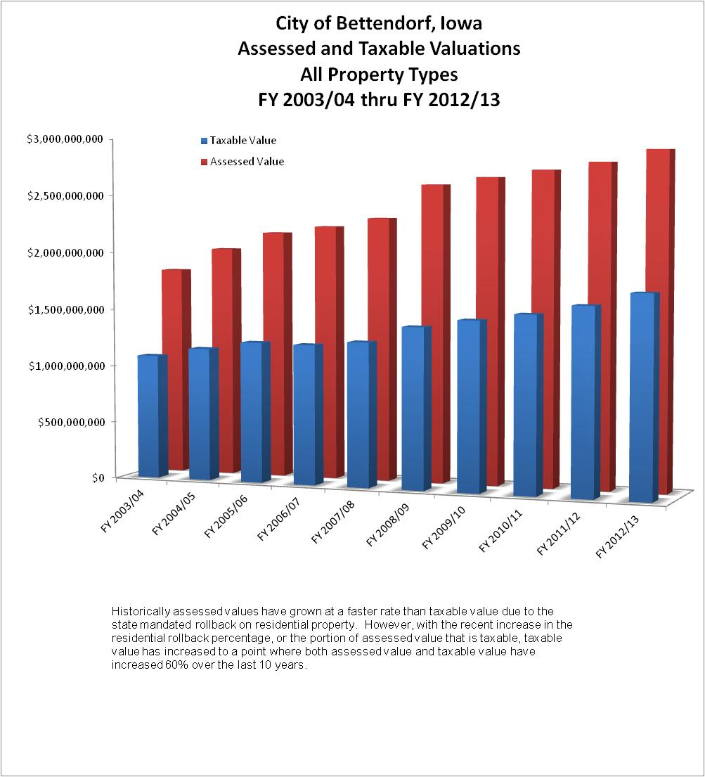

Slide 56
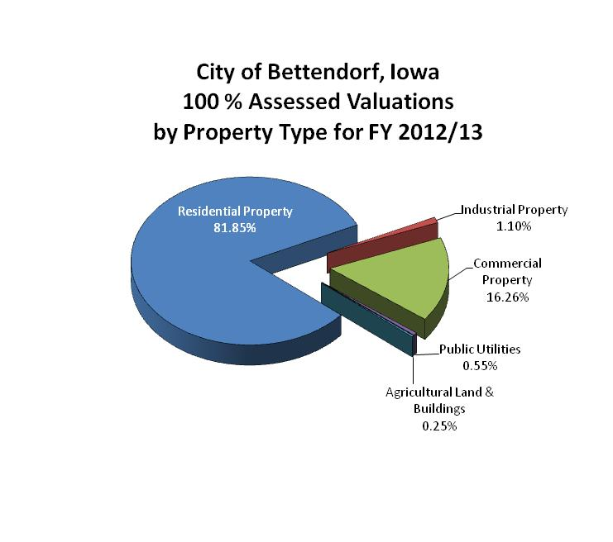
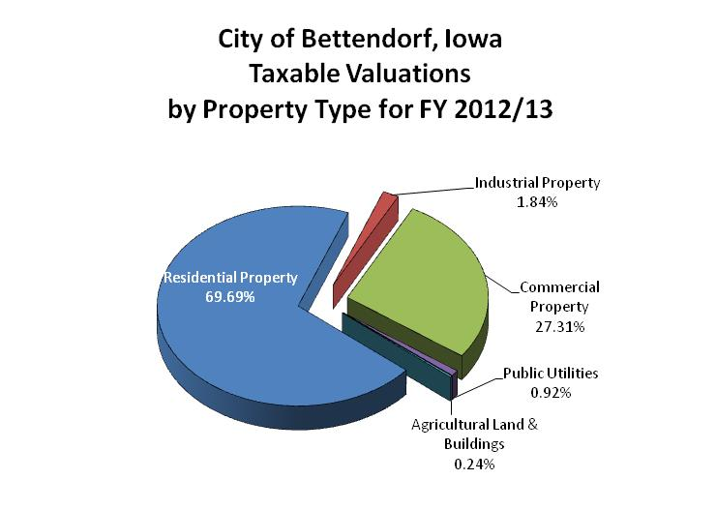

Slide 57
