Slide 1

Fiscal Year 2013/14
Budget Highlights
$ 87.1 million

Slide 2
FY 2013/14 Budget
“Stays the course” and “follows the financial plan”
we established several years ago and continues our history of:
    Maintaining healthy cash reserves
    Significant levy growth available under $8.10 and ability to implement benefit levies.
    Conservative spending
    Stable revenue streams
    Strong fiscal planning and adherence to fiscal policies

Slide 3
In an effort to continue offering Premier Services to our Citizens, we seek balance in three key areas:
We continue to recognize the need for human resources and operating budgets to grow as the city grows. However, we remain committed to our history of efficiency, conservative spending and being fiscally responsible.
  Operating budgets reflect marginal increases
  Vacant positions are thoroughly reviewed in an effort to downsize, through restructuring and realignment of duties where possible.
  Under utilized and/or outdated programs and services are reviewed for funding in the budget each year.

Slide 4
In an effort to continue offering Premier Services to our Citizens, we seek balance in three key areas:
We’ve continued to fund an aggressive CIP program to maintain/upgrade our existing infrastructure and support our growing community with quality amenities.
  We recognize the corresponding cost and are aware that we have a higher debt levy rate and debt margin ratio than many comparable cities.
  We also recognize the flexibility available to the City in reducing the debt levy and corresponding CIP projects if needed to balance future operating budgets.

Slide 5
In an effort to continue offering Premier Services to our Citizens, we seek balance in three key areas:
We remain committed to making difficult decisions of increasing revenues through taxes and user fees “incrementally”, if needed, to balance our budgets annually as our costs increase.
  In FY 12/13 the City’s overall cost of services including property taxes, sewer and storm water fees and solid waste fees ranks 3rd lowest among 30 Iowa cities with populations of 10,000 or more.
  We do not endorse deferring or holding off on raising fees and taxes only to later having to “spike” the rates to balance the budget.

Slide 6
We recommend balance within these three key areas in FY 13/14 by:
1) Continuing our conservative spending:
  The FY 13/14 budget addresses six major issues that reduced revenue or increased expenditures
  We recommend an especially conservative approach in light of the proposed commercial property tax rollback and capping of future growth of property tax revenue across all property classes.
  We have reconciled all funds with the exception of the General Fund
    $155,623 shortfall
      Review of all open positions
      Further reduction of operating budgets
      Increase in the levy rate
      Draw down the General Fund balance

Slide 7
We recommend balance within these three key areas in FY 13/14 by:
2) Funding Aggressive CIP Program previously discussed:
  Supports our growing community’s infrastructure needs
    (New and existing Roads, Storm water improvements, Sewer expansion)
  Maintains and enhances our City’s Cultural and Recreation amenities (FMAS, Library, Parks, Recreation Trails, Golf improvements etc.)
    Impact:
  Maintains Debt Levy Rate at $5.00 per $1,000 assessed taxable valuation
  The proposed Debt Margin Ratio is approximately 76% for FY 13/14

Slide 8
We recommend balance within these three key areas in FY 13/14 by:
3) Lastly, continuing our practice of “raising revenues incrementally” as planned during the last several years:
    User Fees:
  Recommend planned incremental increases in several Enterprise Funds’ user fees:
    3% Garbage, $0.20 Sewer, $0.35 Storm water . The increased user fees will continue to allow those operations to be self-sufficient and are primarily project driven.
    Property Taxes:
  We do recommend MAINTAINING the current levy rate at $12.55
  However, despite maintaining the levy rate, taxes on residential property will increase:
    4.07% increase in the rollback on residential property (50.75% to 52.82%); and
    1.8% average increase in assessed valuations city wide.
      Maintaining the levy rate will allow the City to benefit from $890,241 of additional taxes needed to support current City operations.
          Bettendorf continues to realize Excellent Growth in our tax base which allows greater flexibility for budget priorities. Gross values increased $51.2M.

Slide 11
Budget Highlights - FY 2013/14 Budget:
1) Maintain the City’s Levy Rate at $12.55
Bettendorf is one of a few Iowa cities with a General Fund levy below $8.10. This allows a 7% growth equating to $989,608 of potential property taxes.
Bettendorf also has capacity within the “amount necessary” levies, which if implemented equates to another $4.7 million in taxes.
  Police & Fire Retirement
  FICA & IPERS
  Other Employee Benefits (Health Insurance)
  Liability Insurance
 | FY 12/13 | FY 13/14
General Fund | $7.55 | $7.55
Health Insurance | 0 | 0
Liability Insurance | 0 | 0
Police & Fire Pension | 0 | 0
Debt Service | $5.00 | $5.00
Levy Rate | $12.55 | $12.55

Slide 12
Annual Property Tax Impact of
Maintaining the $12.55 Levy:
Residential (Rollback increased to 52.8%) | Impact
$100,000 Assessed Value | +$25.91 ($2.16 per month)
$162,235 Assessed Value (Median) | +$42.04 ($3.50 per month)
$250,000 Assessed Value | +$64.78 ($5.40 per month)
Commercial (Rollback remains 100%) | Impact
Any Assessed Value | $0.00 (-$0.00 per month)
Despite maintaining the levy rate, taxes on residential property will increase due to:
  4.07% increase in the state mandated rollback on residential property (50.76% to 52.82%)
  4.91% average increase in residential assessed valuations city wide

Slide 13
Taxes Current Year
How We Compare to Other Cities?
In order by Levy Rate of all Iowa cities with populations over 20,000, plus Clive

Slide 14
FY 2013/14 Budget Highlights
  Provides funding for most existing City services:
    Maintains stable operating budgets. Largest increases resulting from Employee Health Insurance, Risk Management, Police & Fire pension, IPERS and fuel related costs. Continues close monitoring of over-time
      Funds Road Salt budget and liquid application program at $500,000
      Funds a program to begin Emerald Ash Borer treatment on city properties.
    Funds wage increases for all union and non-union employees
    Elimination of the administration of the Section 8 program
    Reduction/Elimination of the Transit Loop service
      (Federal grant ends 6/30/13)

Slide 15
FY 2013/14 Budget Highlights
Major Budget Issues | General Fund | Other Funds | Total City-wide
Risk Management | 12,888 | 80,369 | 93,257
Health Benefit | 210,150 | 234,579 | 444,729
MFPRSI (26.12% to 30.12%) | 211,735 | 0 | 211,735
IPERS (8.67% to 8.93%) | 15,904 | 9,871 | 25,775
Wage Increases (Union Contracts, COLA, Deferred, Merit, Steps & Contracted Employees) | 320,058 | 70,973 | 391,031
Condo & Coop Reclassification |  |  | 112,039
TOTAL | $770,735 | $395,792 | $1,278,566

Slide 16
Union Settlements
Funds final year of four year contracts with all of our bargaining units
Bargaining Unit | FY 10/11 | FY 11/12 | FY 12/13 | FY 13/14
Fire | 0% COLA 2% Deferred | 1.50% COLA 7/1/11 1.50% Deferred 1/1/12 | 2.75% COLA | 2.90% COLA (plus 1% if pension is <35.32%)
Police | 2% COLA | 2.35% COLA .50% Deferred | 3% COLA .25% Deferred | 2.75% COLA .75% Deferred
AFSCME - General | 2% COLA | 3% COLA | 3.25% COLA | 3.50% COLA
AFSCME - Library | 2% COLA | 3% COLA | 3.25% COLA | 3.50% COLA
Non-Union Employees | 2% COLA | 3% COLA | 3.25% COLA | 3.50% COLA

Slide 17
FY 2013/14 Budget Highlights:
3) Projects Major Revenues to remain Stable

Slide 18
Building Permit History

Slide 19
FY 2013/14 Budget Highlights:
4) All Major Fund Balances to remain stable

Slide 20
FY 2013/14 Budget Highlights:
5) Health Insurance –
    Recommend renewal with Wellmark with 11% increase in “total projected maximum costs” vs. 7.5-10% national
    History of health claims: 8 year average increase 9.68% (National average 7.5-10%)
    Maintain Specific Stop Loss at $70K
    Ample cash reserves in excess of $1 million are available to fund claims up to maximum aggregate attachment point (125% of expected claims)
    Health Committee continues to meet regularly to monitor our existing health care plan

Slide 21
FY 2012/13 Budget Highlights:
6) Liability Insurance –
Total Liability Insurance up $93,257 or 13.56%.
  Workers Compensation Fees up: $80,887 or 19.92%
      Mod rate 1.05 due to Actual Losses exceeding Expected losses in one of the last three years with a “good” year dropping off
      Striving to manage our Work Comp insurance costs although…..
        Continue to have increased wages
        Average 10% State of Iowa published rate increases on various job classifications expected.

Slide 22
FY 2013/14 Budget Highlights:
7) Gaming Revenue - $1.670 million
$1.565 million allocated to supplement operating budgets for:
Enterprise Funds - $1,094,750 up $51,602 from $1,043,148 current year
Economic Development - $215,618
Downtown Improvements - $100,000
General Fund – City Beautification $95,000, July 4th $30,000 & Emerald Ash Borer treatment $30,000
If not for Gaming Revenue, user fees would be significantly higher or property taxes would be needed to supplement budgets.

Slide 23
8) Community Improvement Program
2013 Construction Season: $15.4 million
$1.5 million | 18th St. Maplecrest to Echodale, Spruce Hills to Tech Dr., Avalon to Spruce Hills
$1.3 million | 3rd phase of Tanglefoot, Greenbrier to Utica Ridge 3 lanes, separated trail
$1 million | 1st phase of Hopewell Ave paving, Middle to east line of Century Heights to 18th addition
$500,000 | Utica Ridge Road: Spruce Hills to Tanglefoot Lane – 5 Lane
$1.57 million | Various separated trails: Middle Rd. from Devils Glen to Duck Creek; Devils Glen Rd. from Middle Rd. to Crow Creek Park
$750,000 | Sealcoat Reconstruction Program – Including 26th St.
$1.1 million | Forest Grove Rd. paving – 3 lanes, rec trail
$510,000 | Street Resurfacing Program
$1.12 million | Street Reconstruction Program
$190,000 | Bridge Maintenance Program
$555,000 | Sidewalk Program
$370,000 | Various Community & Economic Development projects

Slide 24
Community Improvement Program
2013 Construction Season: $15.4 million
$700,000 | Forest Grove Park Development
$625,000 | Full Depth Patching Program
$300,000 | Recreation Trails along Crow Creek from Devils Glen to Field Sike
$260,000 | Annual funding for Parks projects
$267,000 | Various Traffic projects
$635,000 | Alley Rehabilitation Program
$250,000 | I-80 water main extension
$275,000 | Miscellaneous Public Works projects
$150,000 | Rural Road Sealcoating Program
$850,000 | Downtown Improvements, Façade program and I-74 relocation program
$515,000 | Various city-wide projects including Library space remodel
$100,000 | Pavement Preservation Program
$25,000 | Curb & Gutter Replacement Program
$15,000 | Pavement Management Program

Slide 25
Community Improvement Program continued
Enterprise Fund Projects: $130,800
Palmer Hills Golf Course | Tee box & sand trap Improvements | $20,000
Family Museum | LED Lighting Replacement in Great Hall | $20,800
Life Fitness Center | Tennis court resurfacing and gym floor repair | $90,000

Slide 26
Capital Equipment Requests
FY 13/14 Budget funds $1,208,323 of new/replacement vehicles
Funds $147,600 of new/replacement electronic equipment
Funds $278,000 of new/replacement capital equipment
  ($140,000 at QCWCC)
$147,000 | Police: 4 detective vehicles, 1 crime scene van
$32,000 | Community Development: Pick-up with utility box
$409,246 | Public Works: 2 ¾ ton pick-ups, 2 1-ton pick-ups, 2 single axle dump trucks
$115,000 | Parks: Utility Cart, 10’ mower, zero turn mower
$370,077 | Storm Water: Sewer Vaccon, ¾ ton pick-up
$135,000 | Solid Waste: Rear load garbage packer

Slide 27
FY 2013/14 Budget Highlights:
9) User Fees -
Continue to adjust user fees, when appropriate, to offset increases in the cost of programs.
Solid Waste | 3% effective 4/1/13
Storm Water | $0.35 per ERU/mo effective 4/1/13
Sewer | $0.20 per 100 cubic feet of flow effective 4/1/13
LFC | Personal training fees increased 1/1/13 (PB Resolution 61-12)
Palmer Hills G.C. | $1 increase to 18 hole rounds, junior rounds, 18 hole carts, small range baskets, junior senior range baskets & introduction of season passes (PB Resolution 53-12)
Splash Landing | Introduction of $25 concession area rental fee (PB Resolution 62-12)
Recreation | $10 increase to adult softball teams & youth flag football, $5 increase to sports & games camp, $2.50 increase to Tot Lot (PB Resolution 57-12)
Family Museum | No fee increase. Fee structures will be examined in January, 2014.
Transit | No fee increase.

Slide 28
Proposed Solid Waste Fee Increase 3%
Continue 3% increases each April 1 to balance revenues and expenditures – BREAKEVEN
With the implementation of single stream recycling carts and trucks, 4% increases may be needed beginning 4/1/16.

Slide 29
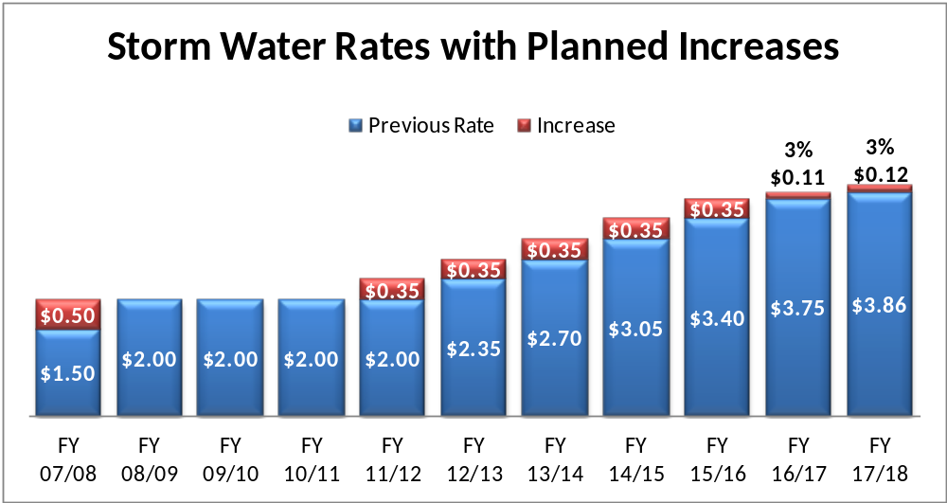
Fee increases are primarily project driven. See CIP for details.

Slide 30
$5.98 million Storm Water Projects thru FY 17/18:
$1.3 million | Stafford Creek Bank Stabilization 18th to Crow Creek Rd., Tanglefoot – Maplecrest
$300,000 | Middle Rd. – Stafford Creek Culvert
$1.3 million | Small storm sewers, sewer linings, intake repair
$490,000 | Hopewell Creek detention at school
$400,000 | Blackbird Creek bank stabilization
$435,000 | Duck Creek stabilization, various phases
$730,000 | Greenway Creek stabilization, Terrace Park Dr. to Golden Valley Dr.
$300,000 | West Pigeon Creek bank stabilization
$720,000 | Pigeon Creek bank stabilization – 53rd to Crow Creek
$549,000 | Small storm water projects

Slide 31
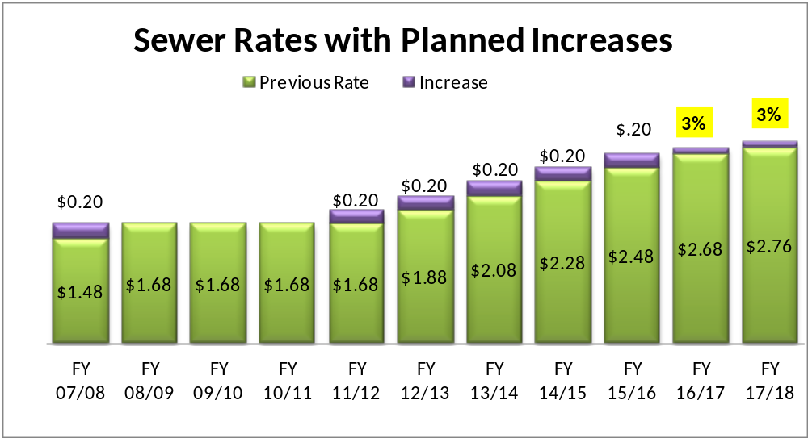
Fee increases are primarily project driven. See CIP for details.

Slide 32
$9.46 million Sewer Utility Projects thru FY 17/18:
$3.5 million | I-80 interceptor sewer from Forest Grove to Indiana, lift station & pumps
$250,000 | Infiltration & Inflow analysis and city-wide improvements
$535,000 | Chimney seals, manhole rehab, sewer televising, pipe lining, etc.
$5.16 million | Joint sewer improvements
$300,000: Debt service estimate on joint sanitary sewer improvements with Davenport.

Slide 33
Annual Impact of Taxes & Fee Changes in
FY 13/14 Budget:
 | Residential Median Value: $162,235 | Small Business Median Value: $253,510
City’s Portion of Property Tax | +$42.04 | No Change
Sewer Fees $1.88 per unit ($0.20 increase) | +$17.64 (22 units/quarter) | +$45.60 (57 units/quarter)
Storm Water Fees $2.35 per ERU ($0.35 increase) | +$4.20 (1.00 ERU) | +$51.87 (12.35 ERU)
Solid Waste Fees $12.75 per month (3% increase) (Based on 65 gal. Cart) | +$4.56 | NA
Total Increase | +$68.44 (+$5.79 per Month) | +$97.47 (+$8.12 per month)
Total Annual Cost of Services | $1,411 | $4,056

Slide 34
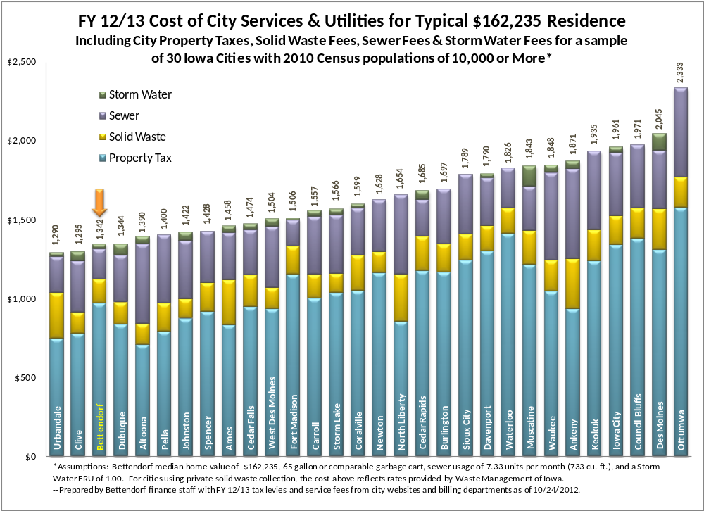

Slide 35
We are pleased to report…
A budget that maintains the current levy rate at $12.55. Despite this, homeowners will see a slight increase in the City portion of their tax bills in FY 2013/14 due to the increase in the rollback.
Commercial property owners will not see a change in the City portion of their tax bills unless their assessed value has changed.

Slide 36
Quote from Moody’s Investors Service April 2012 –
“The assignment of the City’s Aa1 rating reflects the city’s sound financial operations supported by solid reserves and significant revenue flexibility.
City finances are expected to remain healthy due to the existence of solid cash reserves, management’s adherence to a formal General Fund balance policy, and significant operating margin within the tax rate limit. Financial operations have consistently remained sound as the city’s General Fund has posted annual surpluses over the past ten years.”

Slide 37
    Questions
    and
    Answers

