Slide 1
Chicago to
Council Bluffs-Omaha
Regional Passenger Rail Planning Study
Add date here

Slide 2
What is the study?
The Iowa Department of Transportation, in cooperation with the Federal Railroad Administration (FRA)and Illinois Department of Transportation, is studying the feasibility of expanding existing passenger rail service and developing a new regional passenger rail service from Chicago, Ill., to Council Bluffs, Iowa, and Omaha, Neb.
This study will be a major step in assessing the viability of a regional intercity passenger rail system serving Iowa and the Midwest through this corridor.

Slide 3
Purpose of the study
The purpose of this study is to:
  Evaluate potential route alternatives.
  Evaluate levels of service and ridership.
  Analyze environmental impacts.
  Determine a preferred Chicago to Council Bluffs-Omaha passenger rail route alternative for regional intercity passenger rail service.

Slide 4
Study costs
Overall cost of the planning study: $2 million
Costs are allocated between the State of Iowa and FRA.
Implementation costs will be identified during the study.

Slide 5
Collaboration – collecting input
Right now, during the planning and study phase of the project, the FRA and Iowa DOT are collecting input from federal, state and local agencies along with communities and other interested individuals, and the railroad companies that may host the passenger service.

Slide 6
Collaboration – between states
Iowa and Illinois DOTs have a strong partnership to study and evaluate the potential Chicago to Council Bluffs-Omaha regional passenger rail service.

Slide 7
Collaboration – rail groups
The Midwest High-Speed Rail Steering Group, representing nine Midwestern states, executed a Memorandum of Understanding in 2009 supporting Midwest routes connecting to the Chicago hub.
Add local rail groups if applicable

Slide 8
Route evaluation
This study is the first step toward evaluating potential route alternatives between Chicago and Council Bluffs-Omaha for their:
  Costs of construction and operation.
  Travel times.
  Population and urban areas served.
  Ridership and revenue potential.
  Environmental impacts.

Slide 9
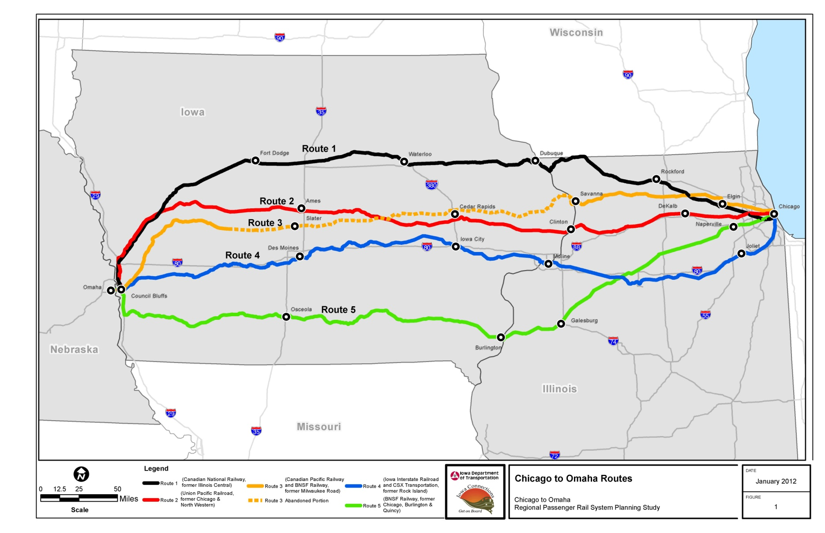
Routes under consideration
Need legend here

Slide 10
Service goals
Once a preferred passenger rail route is identified:
  The number of round-trips will be determined by comparing ridership and revenue forecasts to construction and operating costs.
  The mileage and trip duration will be determined. All route alternatives being reviewed are approximately 500 miles long.

Slide 11
Service goals
  The final speed will be determined by assessing how higher speeds might improve demand for the passenger service versus the costs to obtain higher speeds. The study is based on initial maximum speeds of 79 to 90, or 110 mph.
  The estimated cost for a round-trip ticket will be determined. To provide a reference, a typical fare for the 300-mile trip between Chicago and St. Louis ranges from $48 to $104 per person.

Slide 12
Public and economic benefits
It is anticipated that if the project is implemented it will:
  Help create jobs.
  Improve our nation’s transportation infrastructure, which is used for both freight and passenger transportation.
  Assist in providing transportation alternatives to the citizens of Illinois, Iowa and Nebraska.

Slide 13
Public and economic benefits
It is anticipated that if the project is implemented it will:
  Generate business revenues within Illinois, Iowa and Nebraska, including:
    Materials supply (steel, fuel).
    Services (housing, food, utility).
These numbers will be forecast during the study using standardized methods approved by the federal government.
  Encourage transit-oriented development.

Slide 14
Public and economic benefits
It is anticipated that if the project is implemented it will:
  Provide upgrades to highway-railroad crossings, including improved grade-crossing signal systems that will improve motorist and railroad safety.
  Provide reliable, all-weather transportation to travelers between Chicago and Council Bluffs- Omaha.

Slide 15
Environmental benefits
It is anticipated that this project will:
  Reduce greenhouse gas emissions.
  Contribute to fuel savings.
  Reduce vehicle miles traveled by automobiles.
  Reduce highway congestion.
  Incorporate Iowa and Illinois DOTs’ “GreenLine” vision – a program advancing innovative, sustainable practices.

Slide 16
What is happening now?
As part of the study, development is in process for the following documents.
  Tier 1 Environmental Impact Statement (EIS)
  Service Development Plan (SDP)

Slide 17
Tier 1 EIS
A Tier 1 EIS is a corridor-wide, broad or “service level” environmental document used to:
  Evaluate potential route alternatives.
  Determine preferred route alternative.
  Identify cities for potential station stops.
  Prepare draft EIS and obtain public and agency input.
  Identify future “project level” (Tier 2) environmental studies.

Slide 18
Tier 1 EIS
Environmental impact analysis, including:
  Compile geographic information system database of environmental resources.
  Evaluate feasible route alternatives.
  Corridor-level environmental impact analysis (wetlands, waterways, regulated materials, historical properties, protected resources, threatened and endangered species and environmental justice).
  Noise and vibration analysis.
  Energy consumption analysis.

Slide 19
SDP
The Service Development Plan is a document that lays out the overall scope and approach for the proposed service.

Slide 20
Tier 1 EIS and SDP timing
The Tier 1 EIS and related SDP will require approximately 18 months to complete.
Completing these elements will result in the selection of a preferred route alternative and initial definition of the potential passenger rail service.

Slide 21
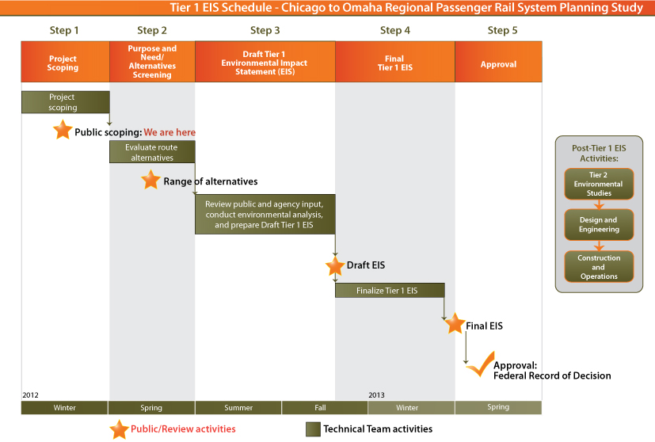
Tier 1 EIS
Public involvement schedule

Slide 22
Following Tier 1 EIS and SDP
If the State of Iowa decides to move ahead with implementing the project and if funding for implementation and operation is established, Tier 2 National Environmental Policy Act (NEPA) studies (project-specific study for one or more sections of the preferred route) will need to be completed.

Slide 23
Following Tier 1 EIS
After any project-specific Tier 2 NEPA studies are completed and a final service design of the Chicago to Council Bluffs-Omaha passenger service is determined, the next steps are:
  Infrastructure construction
  Equipment procurement
  Operations

Slide 24
Provide your input to the study
Log on to www.iowadot.gov/chicagotoomaha/
Call the hotline at 800-488-7119
Send an email to email@chicagotoomaha.com
Attend an in-person or online, open house meeting

